Slide 1
JAVA Versions from beginning To till date

Slide 2
agenda
Introduction
'Just Another Virtual Accelerator’ [ Java ]– Enabling Innovation and Development Across the Digital landscape.

Slide 3
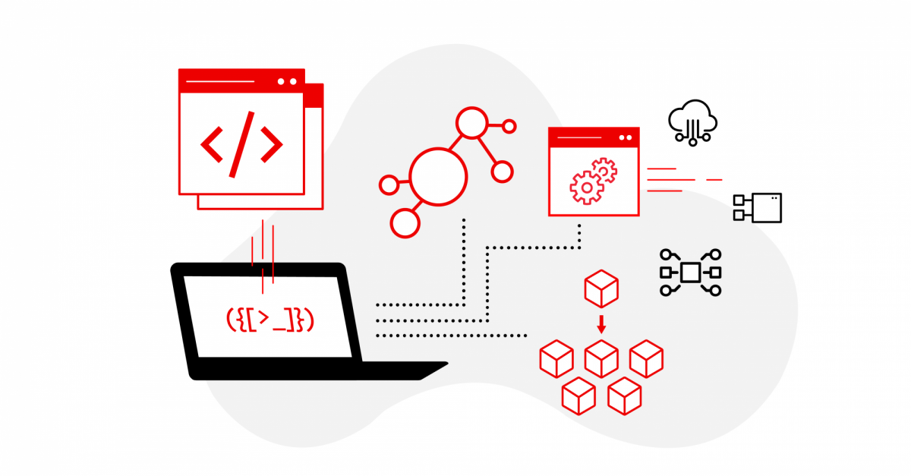
The power of java

Slide 4

Its versions :
The latest version is Java 22 released in March 2024, and the latest long-term support (LTS) version is Java 21 released in September 2023, which is one of a few LTS versions still supported, down to Java 8 LTS.

Slide 5
Here is a table of Java versions from the beginning to the present, with the latest version at the top:
Version | Release Date
Java 20 | March 2023
Java 19 | September 2022
Java 18 | March 2022
Java 17 | September 2021
Java 16 | March 2021
Java 15 | September 2020
Java 14 | March 2020
Java 13 | September 2019
Java 12 | March 2019
Java 11 | September 2018
Java 10 | March 2018
Java 9 | September 2017
Java 8 | March 2014
Java 7 | July 2011
Java 6 | December 2006
Java 5 | September 2004
Java 1.4 | February 2002
Java 1.3 | May 2000
Java 1.2 | December 1998
Java 1.1 | February 1997
Java 1.0 | January 1996

Slide 6
History of java
Java is an Object-Oriented programming language developed by James Gosling in the early 1990s. The team initiated this project to develop a language for digital devices such as set-top boxes, television, etc. Originally C++ was considered to be used in the project but the idea was rejected for several reasons(For instance C++ required more memory). Gosling endeavoured to alter and expand C++ however before long surrendered that for making another stage called Green. James Gosling and his team called their project “Greentalk” and its file extension was .gt and later became to known as “OAK”.

